Slide 1
COMPUTING LIMITS
When you build something you need two things:
Ingredients to use
Tools to handle the ingredients
Your textbook gives you the tools first (called the limit laws), then the tools (called special limits.)
Just for fun I will give you the ingredients first, then the tools. All of this is on pp. 62-63 of the textbook.
Here we go:

Slide 2
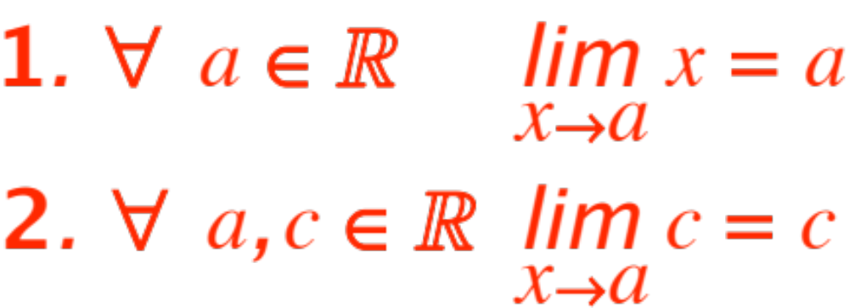
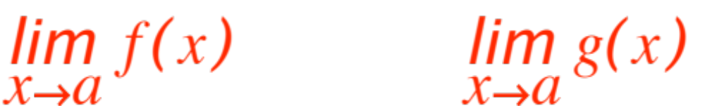
Ingredients. Just two:
(these are nos. 7 and 8 in the textbook.)
Once we have a precise definition of limit the proofs of the two ingredients will be trivial.
Here are the four basic tools. We start by assuming that
and both exist. Then:

Slide 3
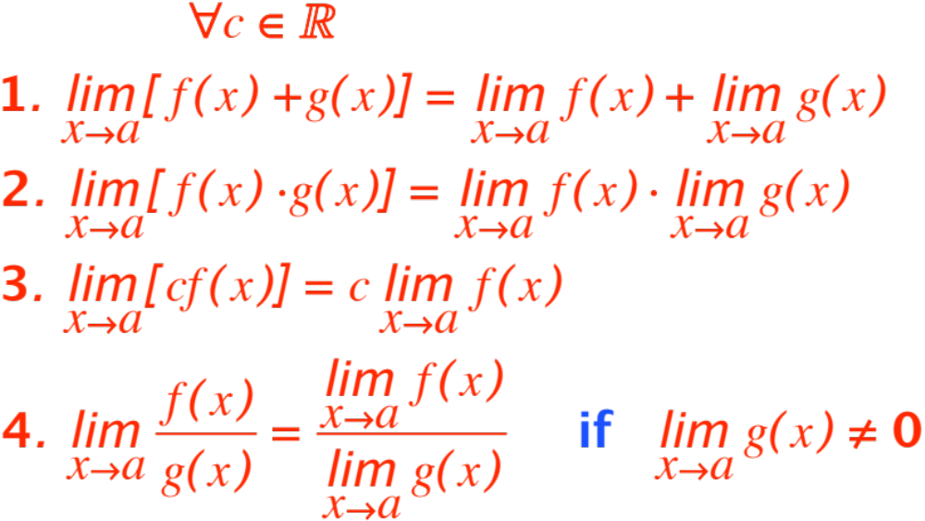
(p. 62 of textbook)

Slide 4
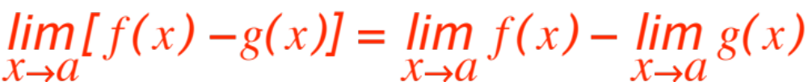
One look at your textbook shows I have dropped the law
Why? (First correct answer gets 1 extra point on yesterday’s quiz)
Given the ingredients we have, we could drop one more law from the list. The first student from this section to e-mail me which one and why will get 30% more added to her/his score on yesterday’s quiz.

Slide 5
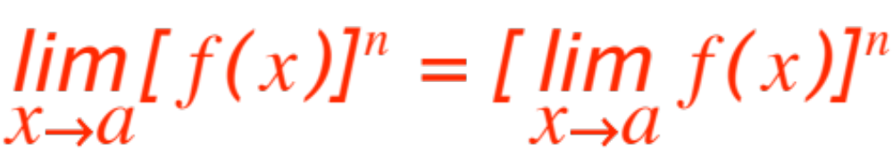

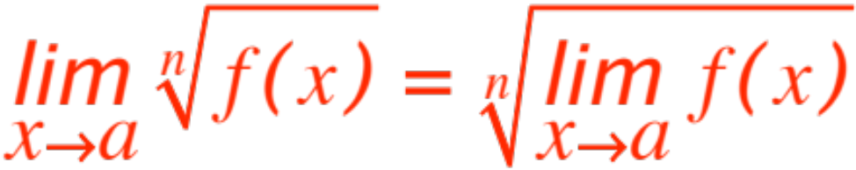
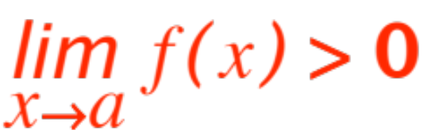

A few more tools to compute limits (listed variously in the textbook, section 1.6)
if
and
(If is even we assume )
A very powerful tool is the Agreement Theorem.
It says:

Slide 6


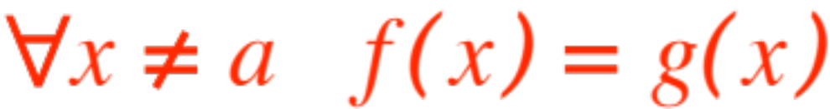

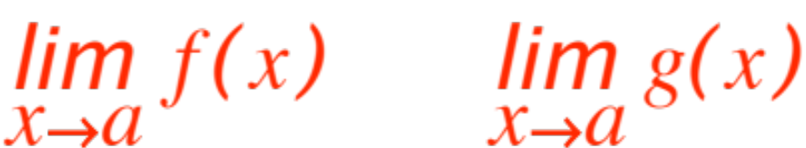
Theorem (the Agreement Theorem) If two functions and are such that
(they agree everywhere but at ! ) then if one of the two limits exists
so does the other and they are equal.
Very often one of the two limits will be easy to compute, the other hard. The theorem says compute the easy one and get the hard one for free!

Slide 7
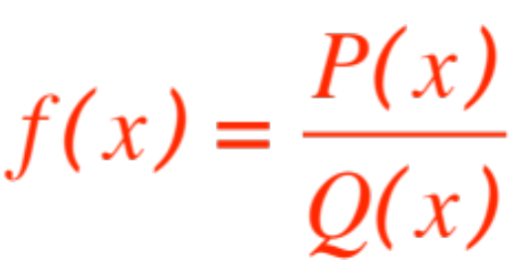

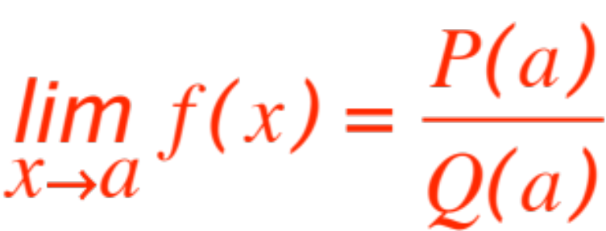
Three more theorems and then examples.
Theorem (substitution theorem) Let
be a rational function (recall that this says that numerator and denominators are polynomials.)
If then
(this says if you can, just plug (substitute) in !)

Slide 8
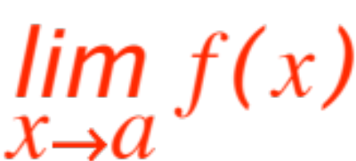
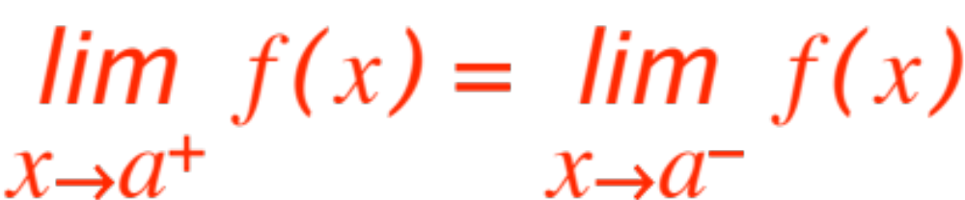
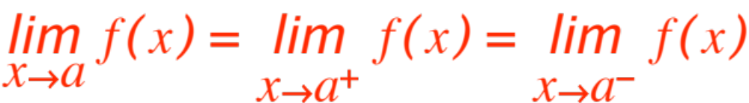
This one looks silly but it is sometimes useful.
Theorem exists iff
In this case
(this says that the right-hand and left-hand limits must agree or the full limit does not exist and, conversely, if the full one exists both one-sided ones must agree with it.)

Slide 9
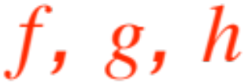
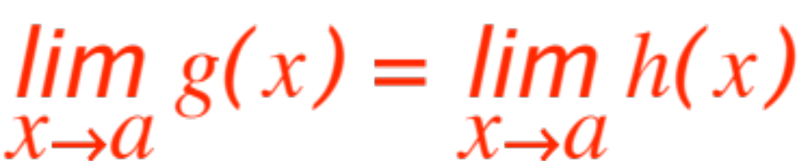
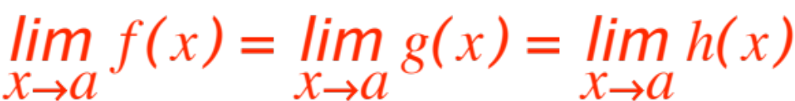
Last one!
Theorem. Let be functions such that
If and
Then
(This theorem is illustratively called the Squeeze Theorem. In Italian it is the Carabinieri Theorem)

Slide 10
Now we do some work, namely, from pp. 69 & ff
9
11
13 (Z)
20
26
30
49
58
59
62

